Slide 2
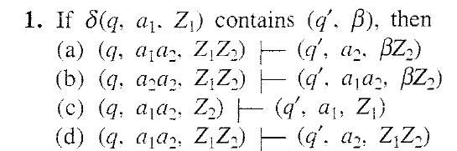
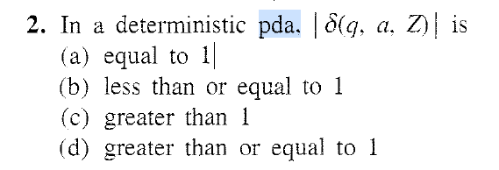

Slide 3
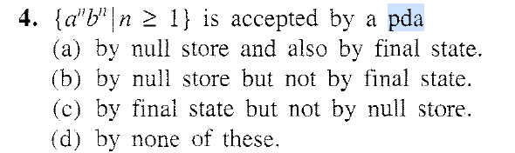
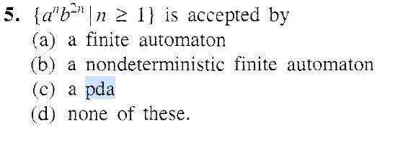

Slide 4
Acceptance by Final state example
Design a PDA For the above language by final state
[Note: Design strategy is
all ‘a’ s will be pushed in the stack,
all ‘b’ s will be rejected PDA will change the state to remember b is encountered and
when trailing ‘a’ is encountered in the input pushed(leading) ‘a’s will be popped from the stack and PDA will change the state also]
A = ({qo, q1,q2 qf}, {a, b}, {a, zo}, δ, qo, Zo, {qf}) where δ is given below
δ(q0, a, Z0) = {(q0, aZ0)}.[first ‘a’ is pushed in the stack]
δ(q0, a, a) = {(q0, aa)}. [Subsequent a’s pushed in the stack]
[Above 2 rules will be used for pushing all ‘a’ s in the stack]

Slide 5
Example PDA Conti…
[Following 2 rules will be used for handling input ‘b’]
δ(q0, b, a) = {(q1, a)}
δ(q1, b, a) = {(q1, a)}
δ(q1, a, a) = (q1, ε) [PDA erases the topmost symbol if it coincides with the current input symbol]
δ(q1, ε, Z0) = {(qf , Z0)}[PDA reaches the final state qf only when the input string is exhausted and then the PDS has only Z0]
But invalid string ‘aababa’ will be accepted by the PDA.
So changes have to be done.

Slide 6
(q0,aababa, Z0) |-(q0, ababa,aZ0) |-(qo,baba,aaZ0) |-(q1,aba, aaz0) |-
(q1,ba,az0) |-(q1, a,aZ0) |- (q1, null, Z0) |- (qf, null, zo)

Slide 7
Changes done PDA Conti…
[Following 2 rules will be used for handling input ‘b’]
δ(q0, b, a) = {(q1, a)}
δ(q1, b, a) = {(q1, a)}
δ(q1, a, a) = (q2, ε) [PDA erases the topmost symbol if it coincides with the current input symbol]
δ(q2, a, a) = (q2, ε)
δ(q2, ε, Z0) = {(qf , Z0)}[PDA reaches the final state qf only when the input string is exhausted and then the PDS has only Z0]
So now invalid string ‘aababa’ will not be accepted by the PDA.

Slide 8
Example PDA Conti…
[Following 2 rules will be used for handling input ‘b’]
δ(q0, b, a) = {(q1, a)}
δ(q1, b, a) = {(q1, a)}
δ(q1, a, a) = (q2, ε) [PDA erases the topmost symbol if it coincides with the current input symbol]
δ(q2, a, a) = (q2, ε) [PDA erases the topmost symbol if it coincides with the current input symbol]
δ(q2, ε, Z0) = {(q2 , ε)}[when the input string is exhausted and then the PDS also is empty.]
Invalid string ‘aababa’ will not be accepted by above PDA.

Slide 9
Acceptance by Final state example
L={a^{n} b ^{m} c ^{n}| m,n>=1}
[Note: Design strategy is
all ‘a’ s will be pushed in the stack,
all ‘b’ s will be rejected PDA will change the state to remember b from q0 to q1
When ‘c’ is encountered and ‘a’s will be popped from the stack and PDA will also change the state from q1 to q2]
A = ({qo, q1,q2,qf}, {a, b}, {a, zo}, δ, qo, Zo,{qf}) where δ is given below
δ(q0, a, Z0) = {(q0, aZ0)}.[first ‘a’ is pushed in the stack]
δ(q0, a, a) = {(q0, aa)}. [Subsequent a’s pushed in the stack]
[Above 2 rules will be used for pushing all ‘a’ s in the stack]

Slide 10
Example PDA Conti…
[Following 2 rules will be used for handling input ‘b’]
δ(q0, b, a) = {(q1, a)}
δ(q1, b, a) = {(q1, a)}
δ(q1, c, a) = (q2, ε) [[PDA erases the topmost symbol ‘a’ with the current input symbol ‘c’]
δ(q2, c, a) = (q2, ε)
δ(q2, ε, Z0) = {(qf , ε)}[when the input string is exhausted and then the PDS also is empty.]
Invalid string ‘aabcbc will not be accepted.

